Slide 1
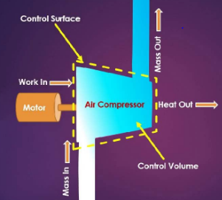
First Law of Thermodynamics for Flow Processes (open systems)

Slide 2
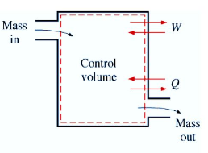
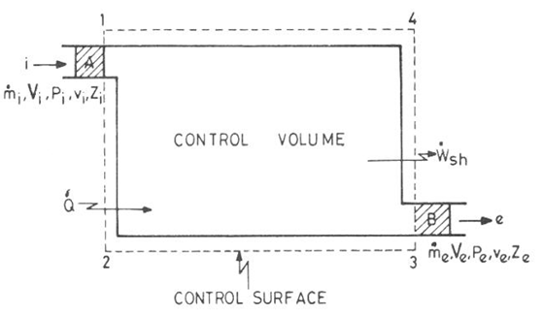
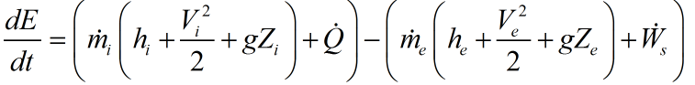
Energy Balance
Time: t
Time: t+dt

Slide 3
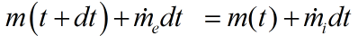
Energy Balance: Control mass to Control Volume
Time: t
Time: t+dt

Slide 4
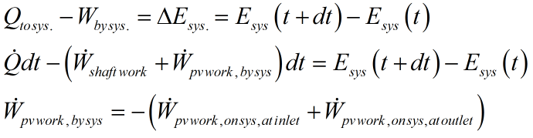
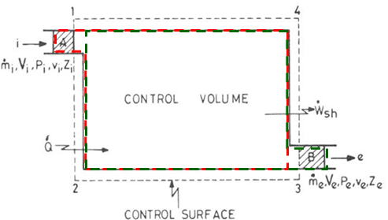
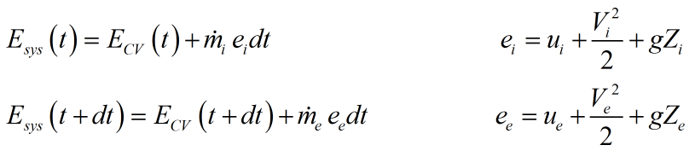

Slide 5
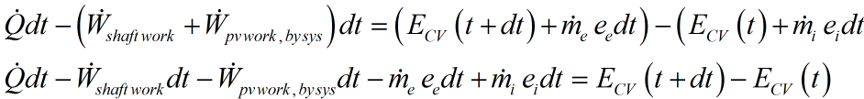
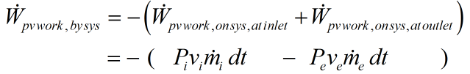

Slide 6
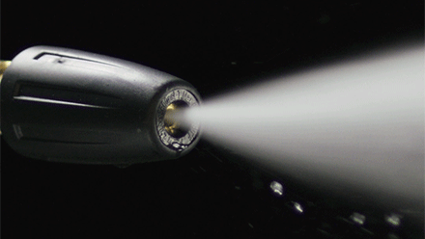
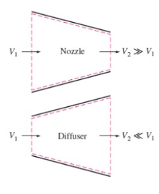
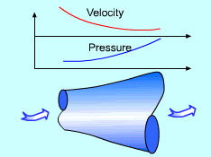
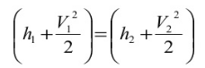
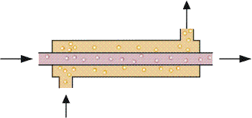
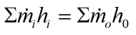
Heat Exchanger

Slide 7
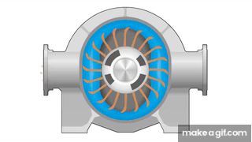

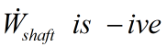
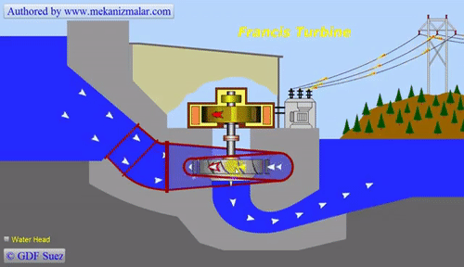
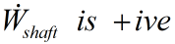
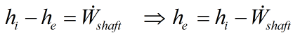
Compressor
(to compress gas)
Work is being done on system (fluid).
Turbine
Work is being done by system (fluid).

Slide 8
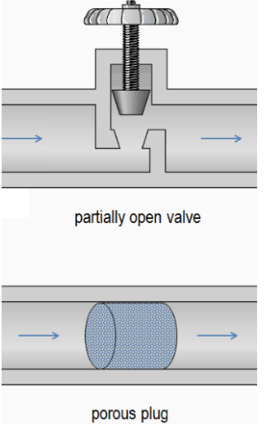
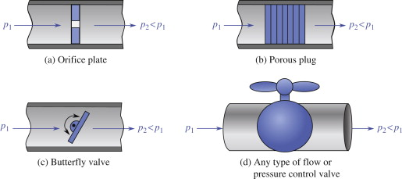
Throttling Process (an Isenthalpic process)
A fundamentally irreversible process.
No Work Transfer
No Heat Transfer
Irreversible Process
Isenthalpic Process
Throttling can be achieved simply by introducing a restriction into a line through which a gas or liquid flows. For example, a partially open valve or a porous plug. Such restriction leads to pressure drop caused by minor losses, although they often account for a major portion of the head loss.

Slide 9
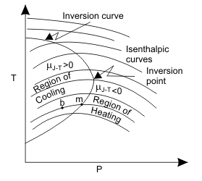
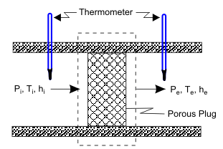
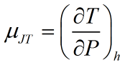
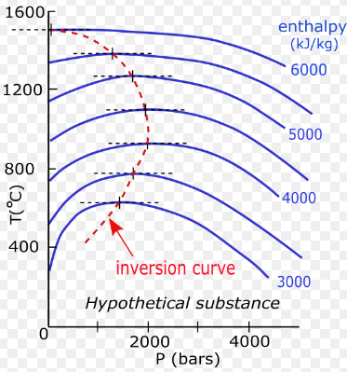
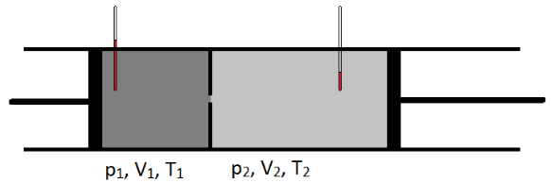
Joule-Thomson effect

Slide 10
A molecular interpretation of Joule-Thomson effect
Interplay of intermolecular attractive and repulsive forces between molecules.
Attractive forces have the dominant effect at long distances, while repulsive forces dominate at short distances. T
In low pressure regime, the average distance between gas molecules is relatively larger. Therefore, intermolecular attractive forces dominate over repulsive forces. So, molecular kinetic energy of gas molecules has to decrease in order to overcome these attractive forces in case of gas expansion. Hence, gas- temperature decreases, and it cools down during throttling. Thus, At low pressures, the Joule-Thomson coefficient should be positive.
In high pressure regime, the effects of both attractive and repulsive forces must both increase, but at a sufficiently high pressure, intermolecular repulsive forces become dominant due to the decrease in average intermolecular distance. Hence molecules get extra kinetic energy while expanding due to repulsive intermolecular forces. Hence, the gas gets heated up.
https://aapt.scitation.org/doi/pdf/10.1119/1.1986124

Slide 11
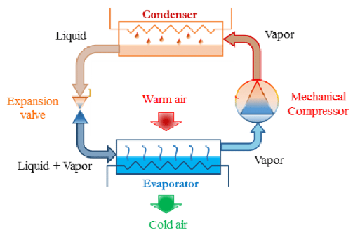
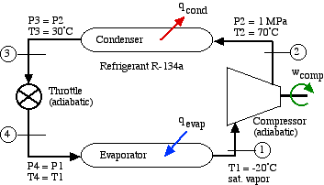

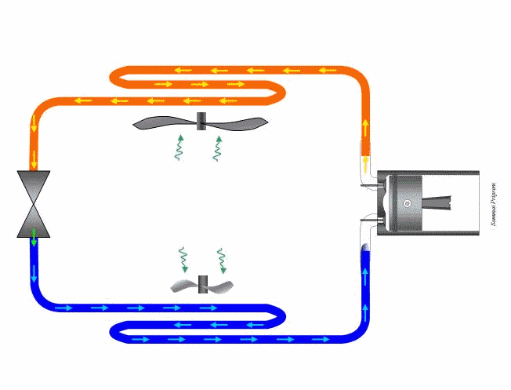
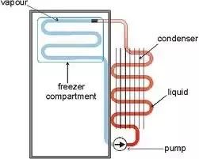
Refrigeration (vapor compression) cycle
Throttling

Slide 12
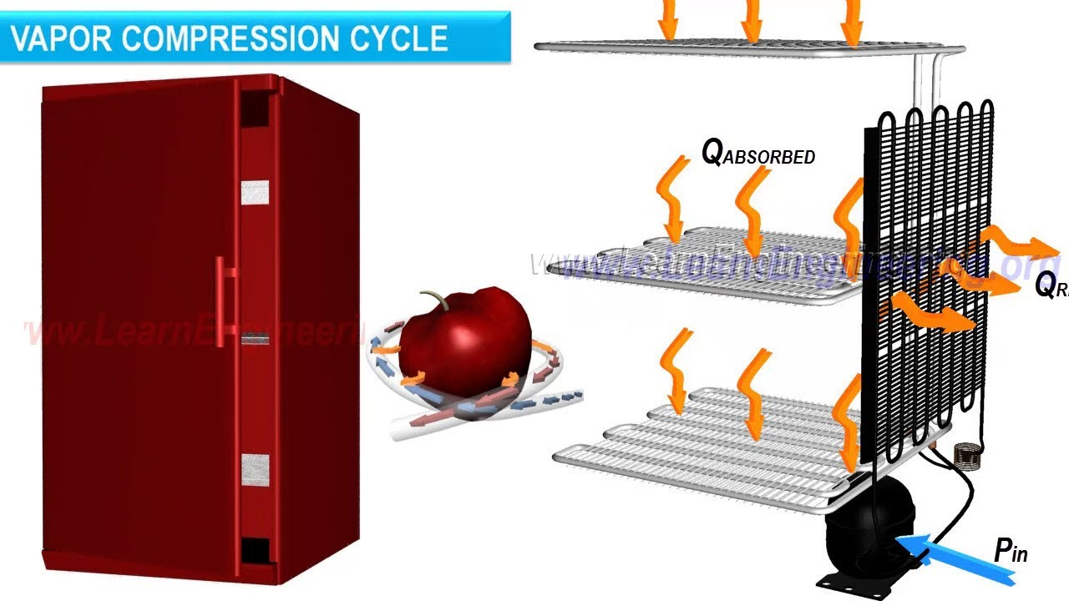

Slide 13
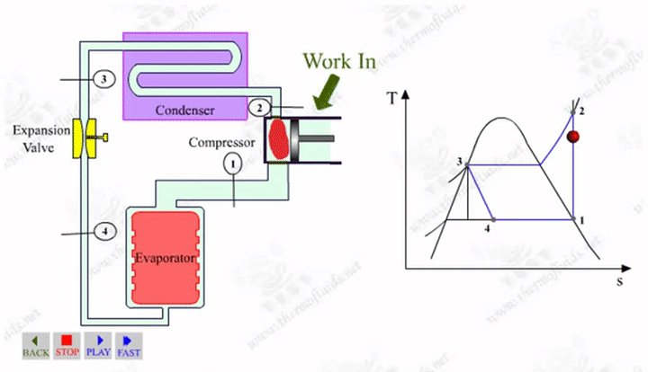
Refrigeration cycle

Slide 14
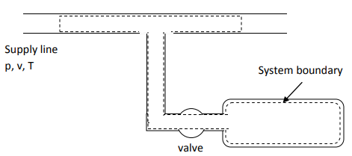
Transient Flow Analysis (Control Mass approach)
Charging of a tank:
(System boundary
After charging)
(After charging)

